Slide 1
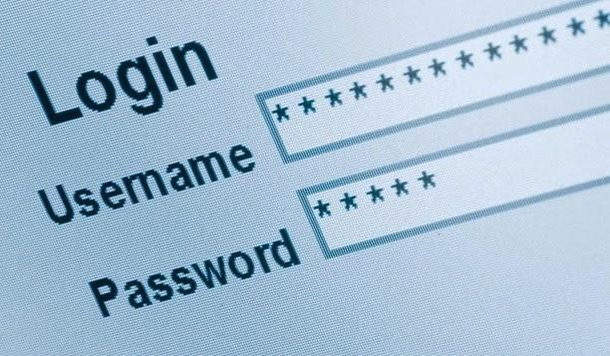
Let's Begin!
Notes:
Teacher notes:
This activity is done best on a whiteboard while the app is running on the projector
Students should volunteer to explain which components will be needed to make this project function

Slide 2
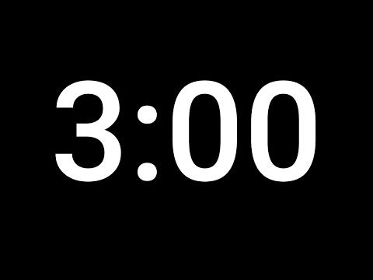
Conditionals in action:
Crack the code
If you figure it out...can you change the password?
Computer
Notes:
Try to have students look at the code to figure out the password. Show the behavior when you enter a wrong password and when you enter a correct password.

Slide 3

create basic conditional statements.
Vocabulary: condition, if statement, else statement, operators
Notes:
Coders should read aloud the objective.

Slide 4
Pick a number!
Think of a number between 1 and 10 and don't tell anyone!
Raise your hand if your number is less than 6
Why did only some of you raise your hands?
Notes:
Activity: Use the following exercise to describe what happens when using conditional statements.
Have coders pick a number from 1-10.
Have coders raise their hand if their number is below 6. If not, coders should keep their hand down.
Only about half your coders should have raised their hand.
Ask the coders why this happened.
Once coders provide their answers, solidify the idea that a condition was met in order for coders to raise their hand. If that condition wasn’t met, something else happened.

Slide 5

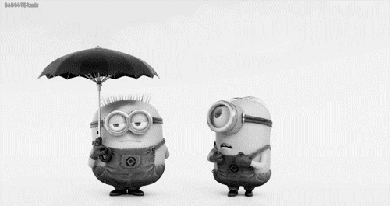
If
it’s raining outside,
I bring an umbrella.
Else,
leave it at home.

Slide 6
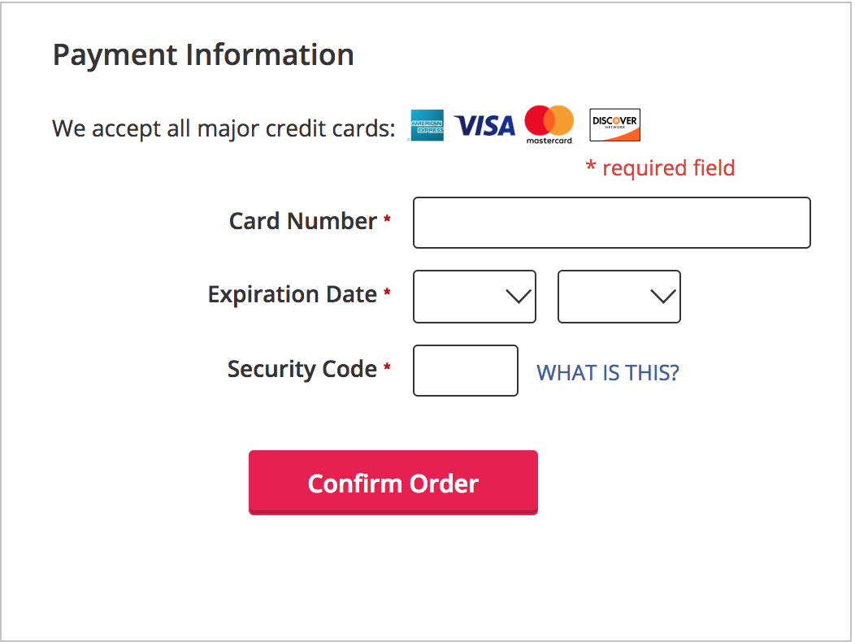
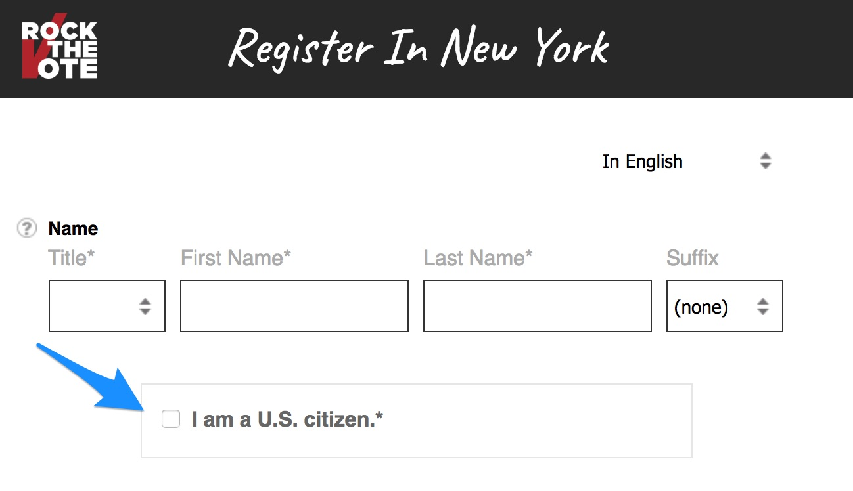
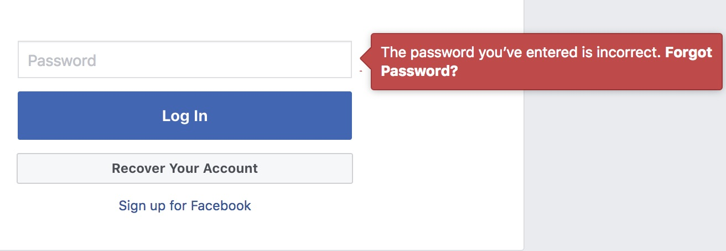
In Websites
What changes based on a true/false condition?
Notes:
Teacher Notes:
As the screenshots go up call on students to point out what is being checked to be true or false
Correct password
Did you check the box?
Did you put info in the required field?

Slide 7
Conditional statements
Sometimes we want to perform different actions for different conditions
  If the password is correct, login. Else, return an error.
You can use conditional statements to do this

Slide 8

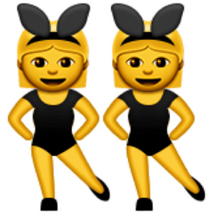
If Statement/ Else Statement
An if statement executes a block of code if the condition is true.
...or else it executes a different block of code because the condition is false.
Notes:
If statements and else statements tend to go together like besties. else statements are pretty co-dependent and ALWAYS need if statements. If statements sometimes stand alone. There's only one code block (else if) that goes between the if statement and the else statement…. Otherwise nothing can come between them!

Slide 9
Conditional Statement Syntax
If 如果 (condition) {
code goes here
}
else 否则 {
code goes here
}
Notes:
Quickly review syntax with students - have a student read the syntax out loud and note that the words "if" and "else" MUST be present for it to be an if/else statement.

Slide 10
Let’s break down this example
let number = 5;
if(number < 10) {
$(".image").hide();
} else {
$(".image").show();
}
Notes:
Don’t spend a lot of time on this slide… the next ones will break it down.

Slide 11
A condition is between the ( ) and the result should be true or false
let number = 5;
if(number < 10) {
$(".image").hide();
}else{
$(".image").show();
}

Slide 12
The body of code is between the { } curly braces and executes only when that condition is met.
Body of code between the { }
if (number < 10) {
$(".button").hide();
}
else
{
$(".button").show();
}

Slide 13
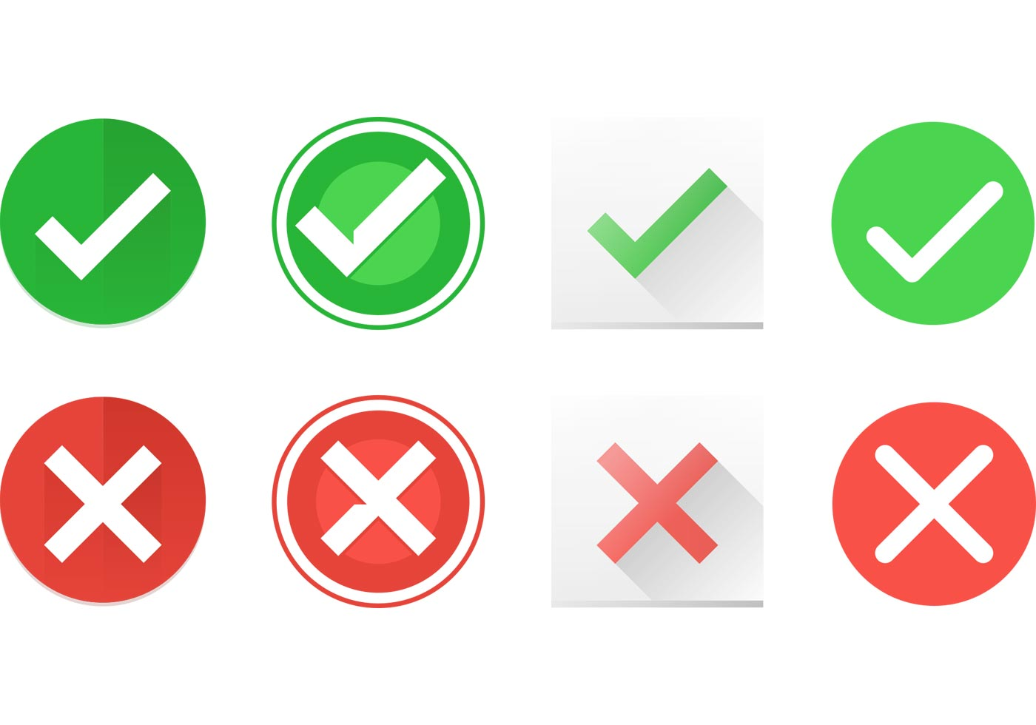
a true condition
executes the block of code in the if body
let number = 5;
if (number < 10) {
$(".image").hide();
} else {
$(".image").show();
}

Slide 14
a false condition
Does not execute code in the if body
let number = 5;
if (number < 2) {
$(".image").hide();
} else {
$(".image").show();
}
Notes:
Explain that when the "if" condition is false, the code in the "else" section should run.

Slide 15
1. Where is the condition?
2. How do you know where the condition is?
3. Where is the body?
4. How do you know where the body is?
5. What executes if condition is true?
6. What executes if condition is false?
let number = 5;
if(number < 10) {
$(".image").hide();
$("body").text("Byeeee!");
}
else
{
$(".image").show();
}
Notes:
Teacher notes: ask coders:
1. Where is the condition?
2. How do you know where the condition is?
3. Where is the body?
4. How do you know where the body is?
5. What executes if condition is true?
6. What executes if condition is false?

Slide 16



True False 运算符
if /else条件语句中的大多数条件将包括运算符。
English | JavaScript | Math Class
小于 | < | <
大于 | > | >
小于等于 | <=
大于等于 | >=
等于 | === | =
不等于 | !==
Notes:
Teacher Notes:
Make sure to talk about === and !== as these will be completely new.

Slide 17



Rapid Conditions
我将向您展示几行代码。
如果条件评估为“真”，请 A
如果条件评估为“假”，投B。

Slide 18
Rapid Conditions
let points = 3;
points = 4;
if (points > 5)

Slide 19
Rapid Conditions
let score = 100;
if(score !== 100)

Slide 20
Rapid Conditions
let name = "Erica";
if(name === "Erin")

Slide 21
Rapid Conditions
let grade = 8;
if(grade <= 8 )

Slide 22
条件在哪里？
什么将执行，什么将不执行？
let testScore = 78;
if(testScore > 90) {
$("body").html("You got an A!");
} else {
$("body").html("There’s room to grow!");
}
Notes:
Teacher notes:
Ask coders:
1. How can we change the value of the testScore variable so that the if executes?

Slide 23
Multiple Conditions
if (分数 >= 90) {
得分 = “A”;
} else if (分数 >= 80) {
得分 = "B";
} else if (分数>= 70) {
得分 = "C";
} else if (分数>= 60) {
得分 = "D";
} else {
得分 = "F";
}
Notes:
Remind students that if-statements and else-statements can hold multiple lines of code

Slide 24

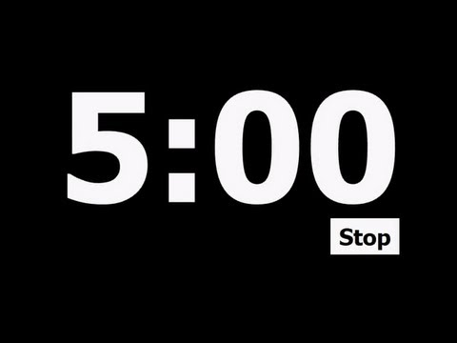
温度计显示：
“沸腾！”如果水高于100度
“冷冻！”如果水低于0度
“喝吧！”如果水介于之间
Computer
Notes:
You may need to help students with the math concepts here.
If greater than 211
If else less than 33
What’s left is everything in between 33 and 211. That is the else.

Slide 25
复合条件
您也可以使用&&（而且）， ||（或），链接两个条件
&&（而且）-要求两个条件语句都为真
|| （或）-要求条件语句之一为真
Notes:
Teacher note:
&& called ampersand, and | | is called pipes (mention that pipes are located under the Backspace key)
With && and ||, we can piece together many separate conditional statements

Slide 26
Rapid Conditions
我将向您展示几行代码。
如果条件评估为“真”，请给我
如果条件评估为“假”。

Slide 27
if("blue" === "blue" && "red" === "green")
What does this condition evaluate to?
What code will run? What is the outcome?
Notes:
Teacher Notes:
Make sure to edit the next few slides so it works with YOUR coders.
Say:
Let’s think for 10 seconds… (pause)...1, 2, 3...

Slide 28
if("blue" === "blue" || "red" === "green"){
What does this condition evaluate to?
What code will run? What is the outcome?
Notes:
Teacher Notes:
Make sure to edit the next few slides so it works with YOUR coders.
Say:
Let’s think for 10 seconds… (pause)...1, 2, 3...

Slide 29
let number = 7;
if(number <= 8 && number >=6)
投票
Notes:
Teacher Notes:
Make sure to edit the next few slides so it works with YOUR coders.
Say:
Let’s think for 10 seconds… (pause)...1, 2, 3...

Slide 30
let number = 7;
if((number >= 8 && number >=6) || number < 10)
(false && ) = false
False || true = true
投票
Notes:
Teacher Notes:
Make sure to edit the next few slides so it works with YOUR coders.
Say:
Let’s think for 10 seconds… (pause)...1, 2, 3...

Slide 31

小结
编码人员将识别，评估和构造复合条件语句
作业：密码登录
Notes:
Say:
Remember, our goal today was to…
identify, evaluate, and construct compound conditional statements

